Slide 1
Chapter 4 Objectives
The CCNA Topics Covered in this chapter include:
  Why VLANs?
  VLAN Memberships
  Access Links and Trunk Links
  Trunking

Slide 2
VLANs – Virtual LANs
Definition: A logical grouping of network users and resources connected to administratively defined ports on a switch.
  Smaller broadcast domains
  Organized by:
    Location
    Function
    Department
    Application or protocol

Slide 3
VLANs – Virtual LANs
A VLAN is a logical grouping of network users and resources connected to administratively defined ports on a switch.
Ability to create smaller broadcast domains within a layer 2 switched internetwork by assigning different ports on the switch to different sub networks.
Frames broadcast onto the network are only switched between the ports logically grouped within the same VLAN
By default, no hosts in a specific VLAN can communicate with any other hosts that are members of another VLAN,
For Inter VLAN communication you need routers

Slide 4
VLANs
VLAN implementation combines Layer 2 switching and Layer 3 routing technologies to limit both collision domains and broadcast domains.
VLANs can also be used to provide security by creating the VLAN groups according to function and by using routers to communicate between VLANs.
A physical port association is used to implement VLAN assignment.
Communication between VLANs can occur only through the router.
This limits the size of the broadcast domains and uses the router to determine whether one VLAN can talk to another VLAN.
NOTE: This is the only way a switch can break up a broadcast domain!

Slide 5
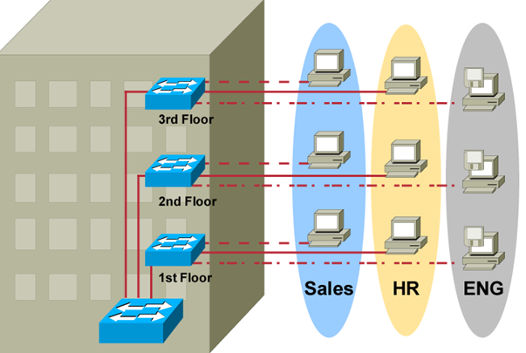
VLAN Overview
  Segmentation
  Flexibility
  Security
A VLAN = A Broadcast Domain = Logical Network (Subnet)

Slide 6
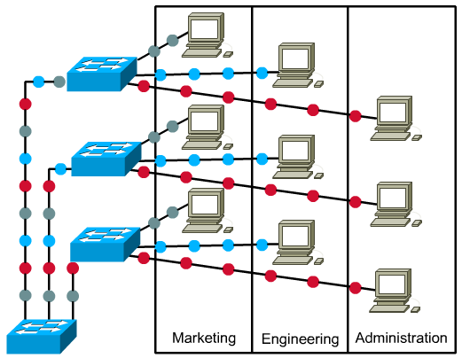
VLAN Overview

Slide 7
VLAN Memberships
Static VLANs
  Typical method of creating VLANs
  Most secure
    A switch port assigned to a VLAN always maintains that assignment until changed
Dynamic VLANs
  Node assignment to a VLAN is automatic
    MAC addresses, protocols, network addresses, etc
  VLAN Management Policy Server (VMPS)
    MAC address database for dynamic assignments
    MAC-address to VLAN mapping

Slide 8
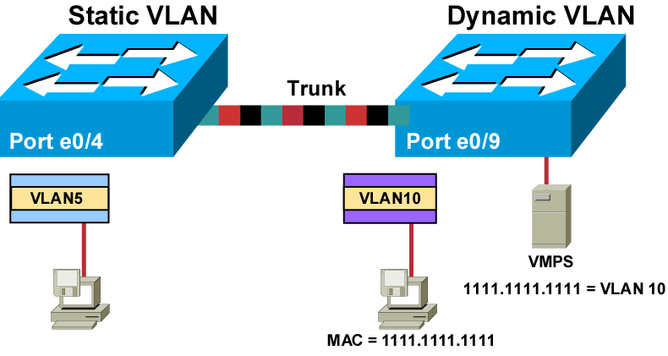
VLAN Memberships
VLAN created based on port is known as Static VLAN.
VLAN assigned based on hardware addresses into a database, is called a dynamic VLAN

Slide 9


LAB – Creating VLAN
Fa 0/1
Fa 0/5
Connect two computers on a switch
Ping and see both are able to communicate
Create two vlans and configure static VLAN’s so both ports are on separate VLAN’s
Test the communication between PC’s
To see the existing VLAN
#Show vlan
To create VLAN
#vlan database
Switch(vlan)#vlan 2 name red
Switch(vlan)#vlan 3 name blue
Assigning ports to VLAN
Sw(config)# int fastEthernet 0/1
Sw(config-if)#switch mode access
Sw(config-if)#switchport access vlan2

Slide 10
Identifying VLANs
Access links
  A link that is part of only one VLAN
Trunk links
  Carries multiple VLANs

Slide 11
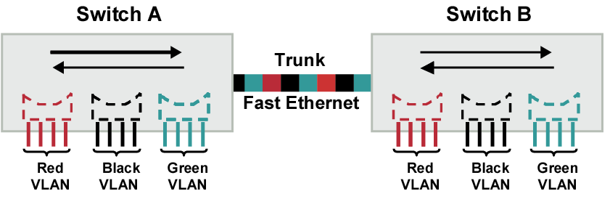
VLAN Operation
VLANs can span across multiple switches.
Trunks carry traffic for multiple VLANs.
Trunks use special encapsulation to distinguish between different VLANs.

Slide 12
Frame Tagging
Definition: A means of keeping track of users & frames as they travel the switch fabric & VLANs
  User-defined ID assigned to each frame
  Frame tagging is a method to identify the packet belongs to a particular VLAN
  Once the frame reaches an exit to an access link matching the frame’s VLAN ID, the switch removes the VLAN identifier

Slide 13
Frame Tagging Methods
There are two frame tagging methods
  Inter-Switch Link (ISL)
  IEEE 802.1Q
Inter-Switch Link (ISL)
  proprietary to Cisco switches
  used for Fast Ethernet and Gigabit Ethernet links only
IEEE 802.1Q
  Created by the IEEE as a standard method of frame tagging
  it actually inserts a field into the frame to identify the VLAN
  If you’re trunking between a Cisco switched link and a different brand of switch, you have to use 802.1Q for the trunk to work.

Slide 14
LAB-Creating Trunk
24
12
1
2
3
4
1
2
3
4
10.0.0.1
10.0.0.4
10.0.0.2
10.0.0.3
Create two VLAN's on each switches
#vlan database
sw(vlan)#vlan 2 name red
sw(vlan)#vlan 3 name blue
sw(vlan)#exit
sw#config t
sw(config)#int fastethernet 0/1
sw(config-if)#switch-portaccess vlan 2
sw(config)#int fastethernet 0/4
sw(config-if)#switch-portaccess vlan 3
To see Interface status
#show interface status
Trunk Port Configuration
sw#config t
sw(config)#int fastethernet 0/24
sw(config-if)#switchport trunk encapsulation dot1q
sw(config-if)#switchport mode trunk
* 2950 Only dot1q Encapsulation

Slide 15
Assigning Access Ports to a VLAN
Switch(config)#interface gigabitethernet 1/1
Enters interface configuration mode
Switch(config-if)#switchport mode access
Configures the interface as an access port
Switch(config-if)#switchport access vlan 3
Assigns the access port to a VLAN

Slide 16

Inter – VLAN Routing (Router on Stick)
R1
10.0.0.1
20.0.0.1
SW1
SW2
FA0/0
9
24
12
1
2
3
4
1
2
3
4
10.0.0.2
20.0.0.3
20.0.0.2
10.0.0.3
Router Configuration
R1#config t
R1(config)#int fastethernet 0/0.1
R1(config-if)#encapsulation dot1q 2
R1(config-if)#ip address 10..0.0.1 255.0.0.0
R1(config-if# No shut
R1(config-Iif)# EXIT
R1(config)#int fastethernet 0/0.2
R1(config-if)# encapsulation dot1q 3
R1(config-if)#ip address 20..0.0.1 255.0.0.0
R1(config-if# No shut
Router-Switch Port to be made as Trunk
sw(config)#int fastethernet 0/9
sw(config-if)#switchport trunk enacapsulation dot1q
sw(config-if)#switchport mode trunk
Create two VLAN's on each switches
#vlan database
sw(vlan)#vlan 2 name red
sw(vlan)#vlan 3 name blue
sw(vlan)#exit
sw#config t
sw(config)#int fastethernet 0/1
sw(config-if)#switch-portaccess vlan 2
sw(config)#int fastethernet 0/4
sw(config-if)#switch-portaccess vlan 3
To see Interface status
#show interface status
Trunk Port Configuration
sw#config t
sw(config)#int fastethernet 0/24
sw(config-if)#switchport trunk encapsulation dot1q
sw(config-if)#switchport mode trunk

